Slide 1

2021-2022 Ramsey Lead Research
The Fox Alliance

Slide 2
Structure
First Contact
Territories Captured
Data Points
Effective/Ineffective Competitor Correspondence
Strengths/Areas of Improvement
End Destination and Importance

Slide 3
First Contact
Prompt Response
Presentation
Authenticity
Notes:
What is our end destination? To know more about our Market—how many competitors, response times, etc. Why is this data important? We want more leads to become prospects and then become clients of ours

Slide 4
Territories
Lead Information
North Houston
West Houston
Southwest San Antonio
Northwest San Antonio
East San Antonio
West Austin
East Austin
Ramsey Firm 5
Ramsey Firm 1
Ramsey Firm 2
Ramsey Firm 3
Ramsey Firm 4
Notes:
How many territories? I captured a total of 7 territories, including North Houston, West Houston, Southwest San Antonio, Northwest San Antonio, East San Antonio, West Austin, and East Austin. In total, Ramsey sent out 5 Firms per territory, making the number of firms 35. Counting the Fox Alliance once and discarding all duplicate firms, this number shrinks to 25. Out of the 25 firms, how many contacted me? 18, meaning 7 for whatever reason didn’t call, email, or send me a message via text.

Slide 5
Territories

Slide 6
Avg. Number of Contacts
7.3 times over 2.5 months
2.92 times per month
The Fox Alliance
10.2 times over 2.5 months
1.02 times per week
Notes:
How many times was I contacted? In aggregate, I was contacted a whole 197 times (over the course of 2 and a half months. This means on average; I was contacted 7.3 times. Removing a very large outlier, this average shifts to about 6.7. This average is what I expect, a little lower if anything as the tracking period lasted just over 2 and a half months. This figure is around .73 times a week. The Fox Alliance contacted me on average 10.2 times across the 5 firms we were captured in, meaning I was contacted just over once a week on average by Waqar or Paul.

Slide 7
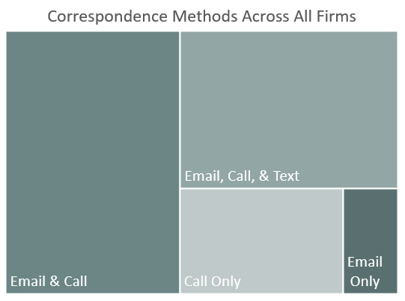
Modes of Contact
Notes:
What were the modes of contact? Email, Phone Call, and Text Messaging. What do these trends indicate? While not the largest category, a sizeable number of firms utilize text messaging as a means of scheduling an initial appointment. Like an automated email, a text message is sent to the lead and the lead can respond whenever they decide. After talking to Waqar personally, I asked how many phone calls he believes he makes a day—he replied 100. Then he told me only 15-20 answer his call—how many people are being missed because they are either too busy to pick up a phone call or see a random number that they don’t want to answer? Where does the Fox Alliance currently fit within this data? We are within the largest category, utilizing Email and Phone-Calling. How can we utilize text messaging? I believe a great way of utilizing text messaging is by sending out an initial calendar invite to schedule a

Slide 8
Avg. Initial Response Time
15.42 Minutes
Fastest Response Time
GWN Securities <10 seconds
Slowest Response Time
78 Minutes
Notes:
What was the average response time? 15.42 minutes. What was the fastest response time? The Fox Alliance consistently had the fastest response times—except for once. GWN Securities, from the North and West Houston Territories. The response time was within the first 10 seconds or so of submitting my request. The Fox Alliance’s automated email as consistently my first form of contact from The Fox Alliance, reaching my inbox within 15-20 seconds. The slowest response time, not listing firms that have yet to contact me—responded in 78 minutes.

Slide 9
Tax
Offer Tax Resources
7
Do Not Offer Tax Resources
18
Notes:
How many firms offer tax resources? Only 7 of the 25 firms offer tax resources along with wealth services. What does this Market Research tell us? There is a major gap in the market; this is something we don’t need to change about our firm that we should totally be marketing to leads. This sample of Dave Ramsey firms only depicts a small number of firms in these territories but I can only assume that if these firms are some of the best, then most other firms in these territories also don’t offer tax solutions.

Slide 10

Effective Correspondence

Slide 11
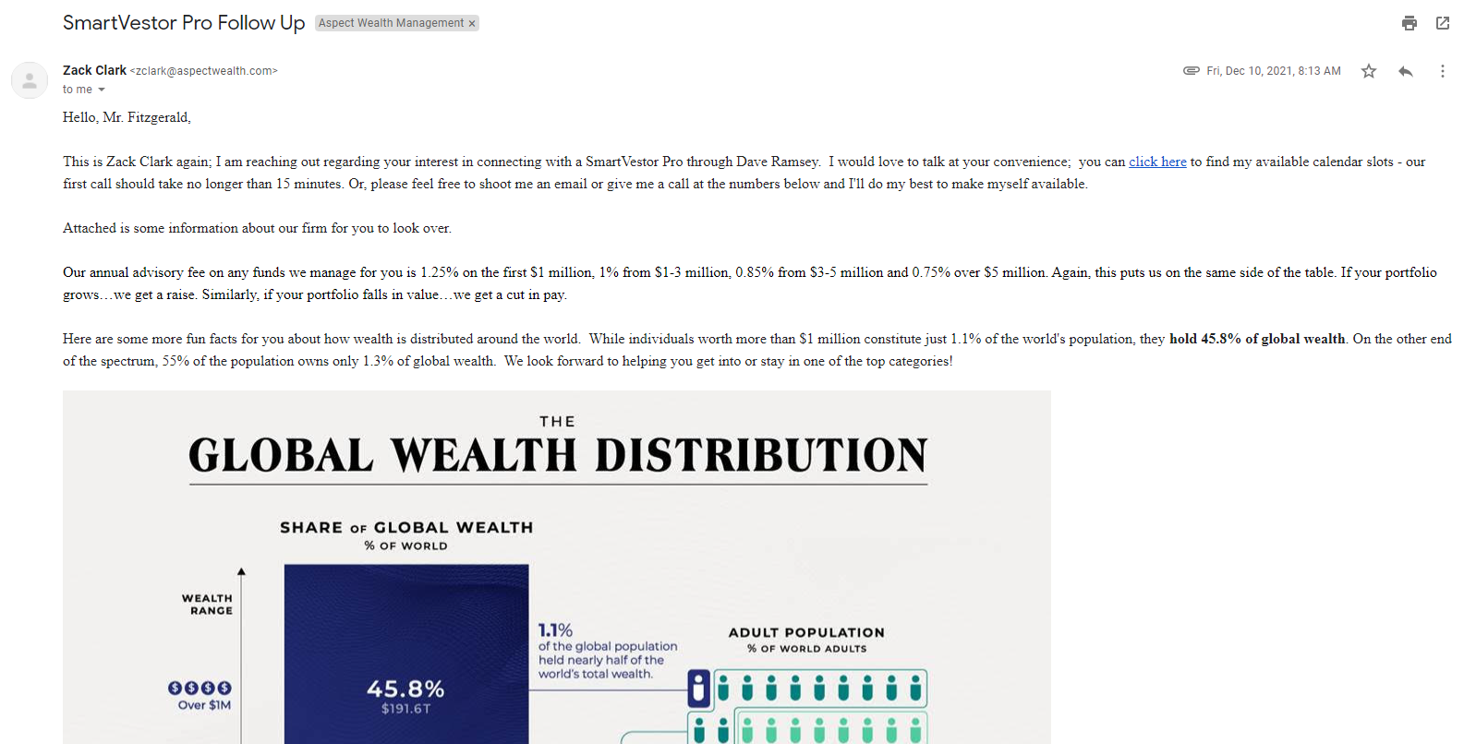

Effective Correspondence
Notes:
What are some responses from competitors that I really liked? I really liked Jennifer Powers’ team and their correspondence. I never felt like their emails were automated, even though they probably were, and I believe that’s because they didn’t use any pictures, videos, or gimmicky sales pitches while emailing me.

Slide 12
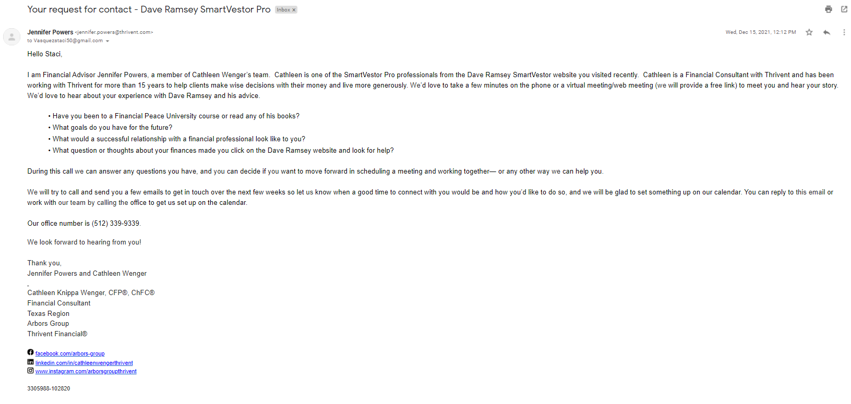
Effective Correspondence
Notes:
What are some responses from competitors that I really liked? I really liked Jennifer Powers’ team and their correspondence. I never felt like their emails were automated, even though they probably were, and I believe that’s because they didn’t use any pictures, videos, or gimmicky sales pitches while emailing me.

Slide 13
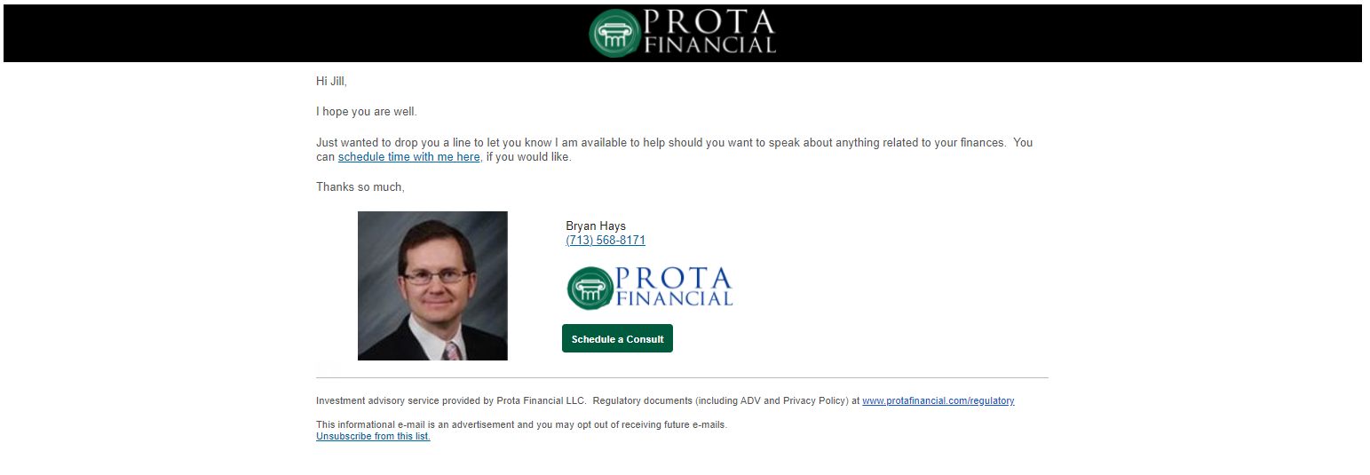

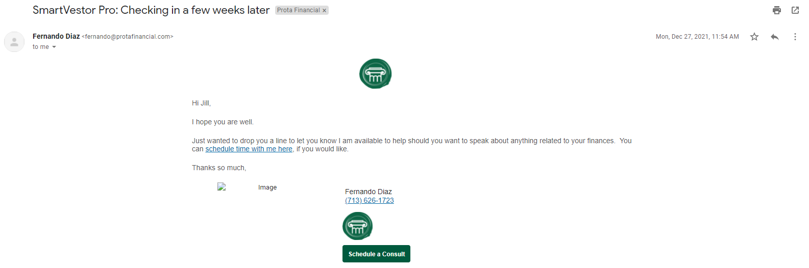
Ineffective Correspondence

Slide 14
TFA Strengths
Prompt Response
Authenticity
Website
Notes:
What is The Fox Alliance getting right? Our speed of correspondence after submitting a request is incredibly fast. I also believe the amount What do I believe we can improve upon and or possibly consider changing in the future?

Slide 15
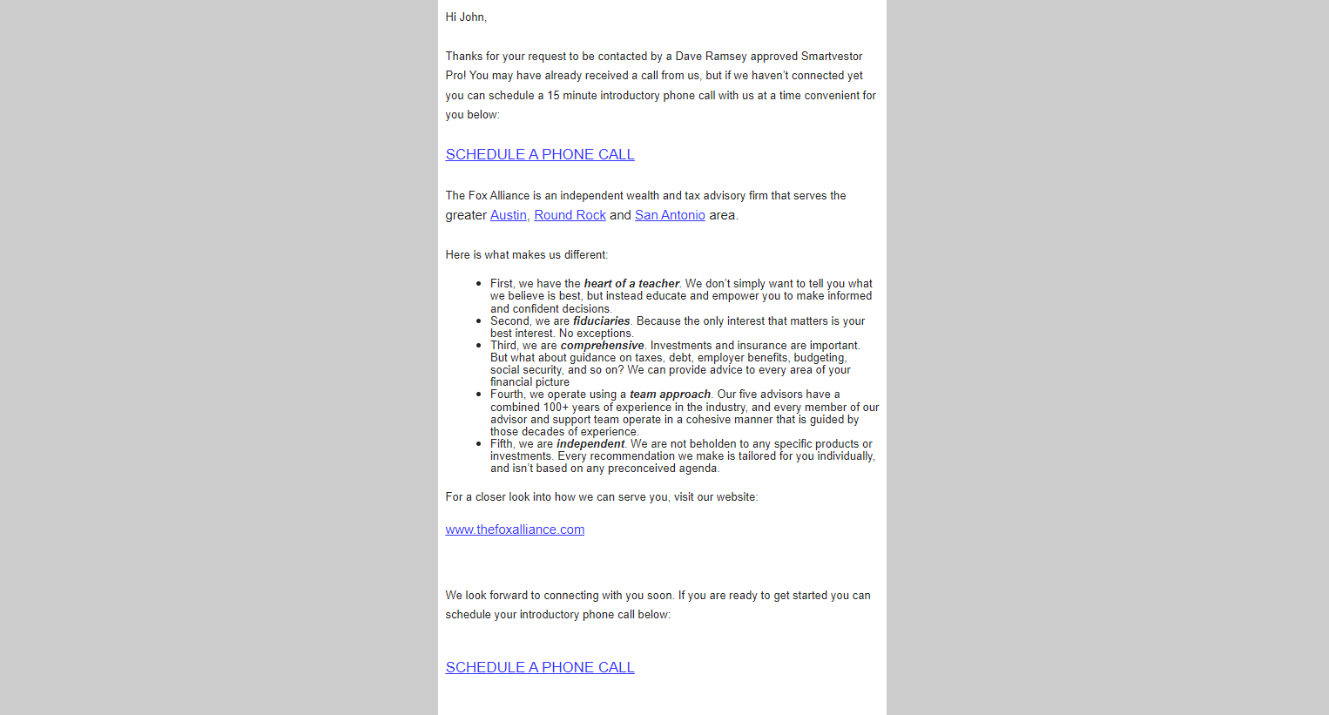
Potential Improvements
Notes:
What is The Fox Alliance getting right? Our speed of correspondence after submitting a request is incredibly fast. I also believe the amount What do I believe we can improve upon and or possibly consider changing in the future?

Slide 16
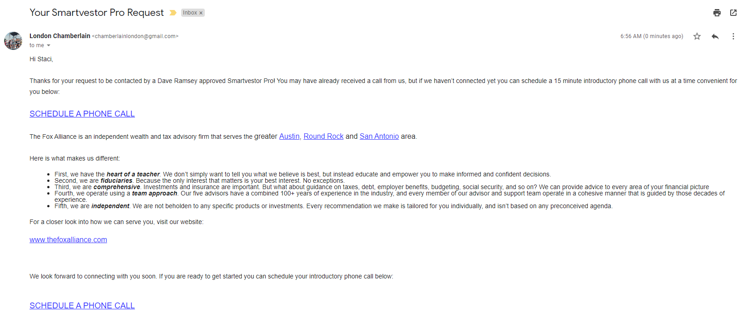

Slide 17
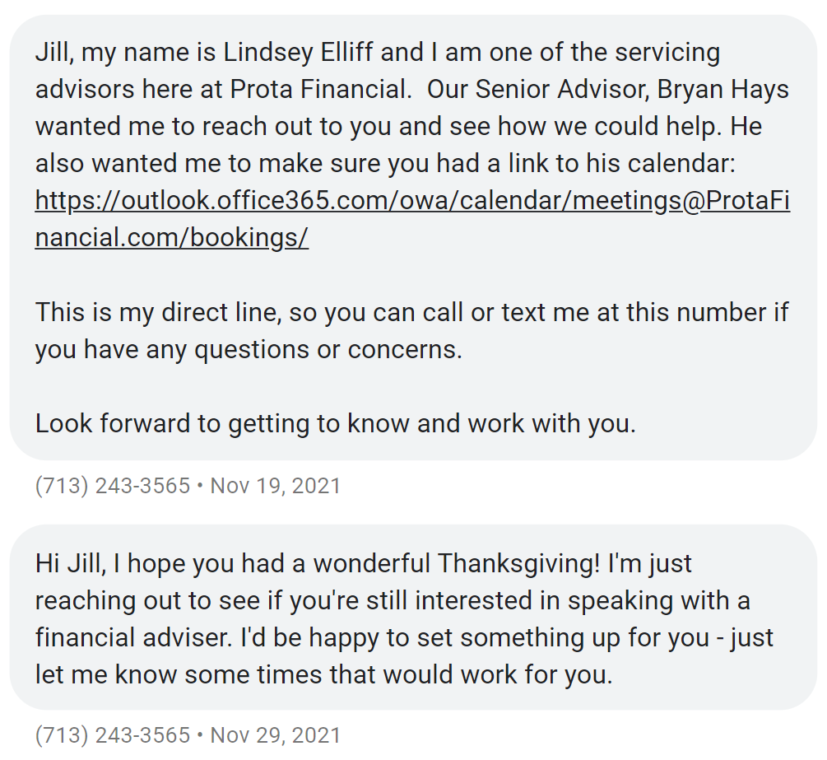
Potential Improvements
Utilize Text Messaging
The Fox Alliance
Link to Website
“When would be a good time to talk”
What We Believe PDF
Notes:
Waqar mentioned around 90% of people he calls don’t answer the phone

